Slide 1




Forage Accenture Virtual Internship
Social Buzz
Data Analysis
Sethuraman B

Slide 2




Today's agenda
Project recap Problem
The Analytics team Process
Insights Summary

Slide 3

Project
Social Buzz, a rising social media platform, to assist them to adapt quickly to it's global scale before its IPO.
An audit of Social Buzz's big data practice
Recommendations for a successful IPO Analysis.
Social Buzz's top 5 most popular categories of content
Recap

Slide 4





Problem
Conduct a comprehensive analysis
Find Social Buzz's top 5 most popular categories of content.
The Segment to on focus.

Slide 5

Andrew Fleming
Chief Technical Architect
The Analytics team
Marcus Rompton
Senior Principle
Sethuraman
Data Analyst

Slide 6



Process
1
Data Understanding:
2
Clean and pre-process data
3
Analyse the data
4
Interpret and validate results
5
Insights

Slide 7

Insights
16 Unique Categories
Here we outline some interesting findings about Social Buzz's categories
Top 5 Reaction types:
Look for positive Sentiments:
84.64%
Top Months with the most posts:
Top 5 Category
Animals
Science
Healthy Eating
Technology
Food
Super Love
Adore
Want
Cherish
Love
Jan 2021
~2126
May 2021
~2,138
Reaction to Animal Posts:
1897 ~7.72%

Slide 8
Viz

Slide 9





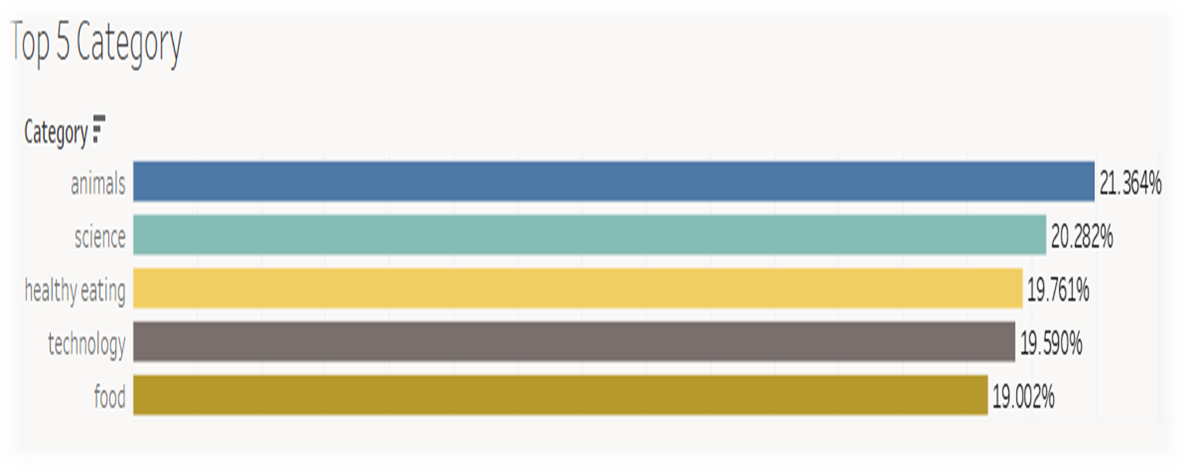
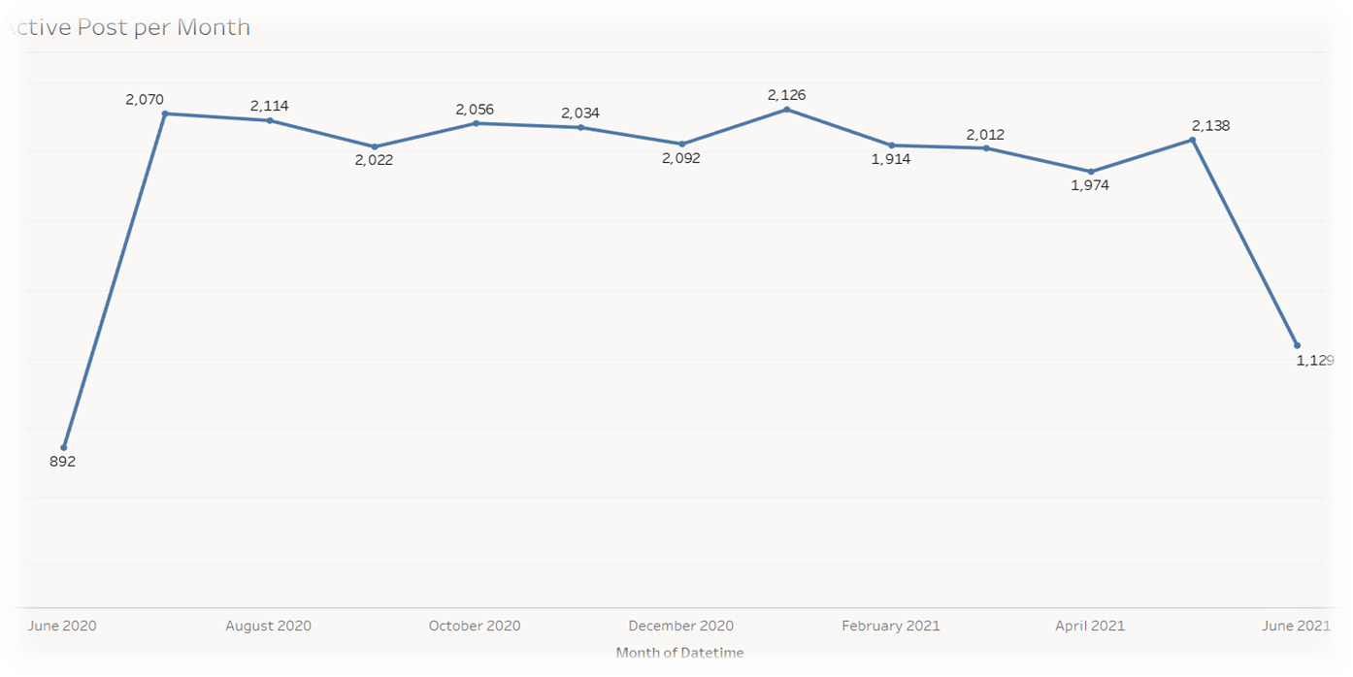


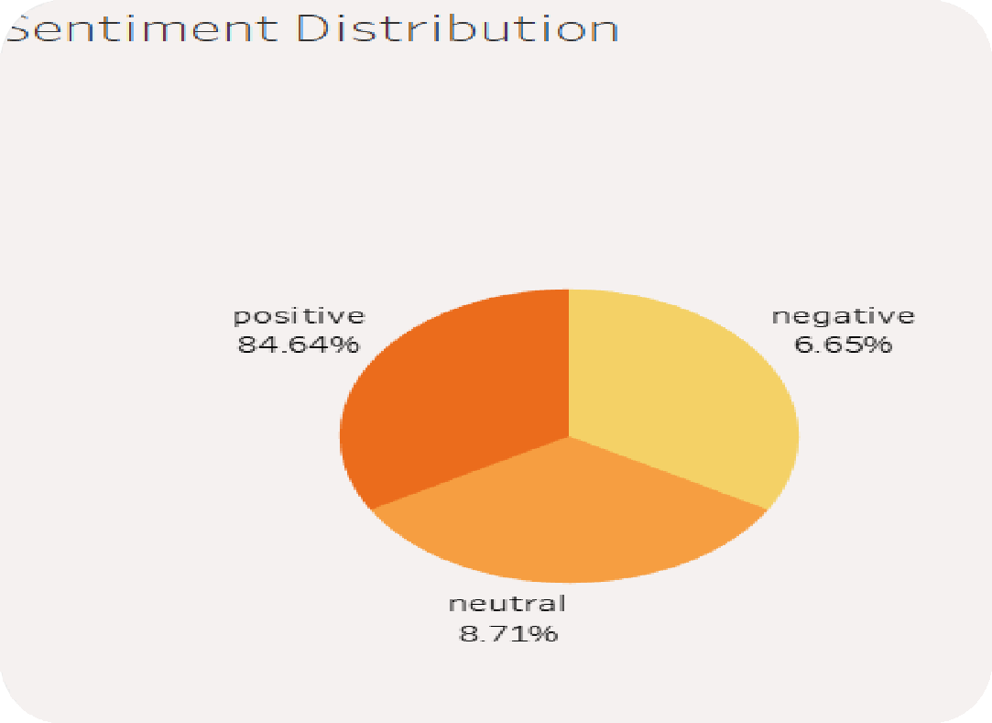
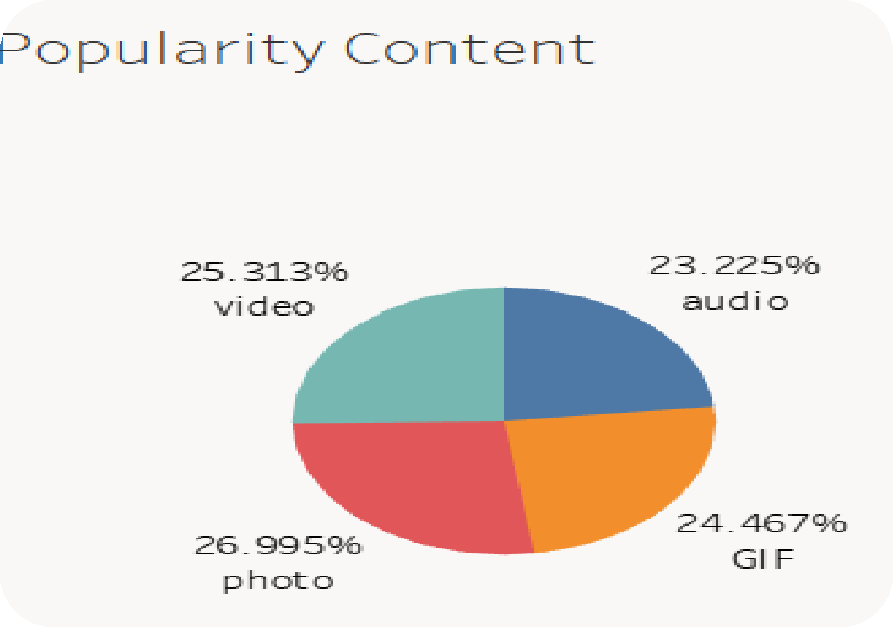




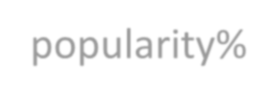





Category
A bar chart is a great way to show popularity for the top 5 categories. It's visually clear and easy to understand
Within the Top 5 Categories, you can then reformat the data to show popularity% share.

Slide 10




Animals and science are the two most popular categories of content, showing that people enjoy "real-life" and "factual" content the most. Users show a preference for content related to Food/Healthy Eating and Science/Technology.
ANALYSIS
Summary
Insights
The platform can leverage this information to encourage content creators in these categories and increase audience engagement. by creating a campaign and work with healthy eating brands to boost user engagement.
It is important to maintain a balanced distribution of content across
the platform to avoid overrepresentation of a single category.

Slide 11
Supporting Link
Excel Link https://docs.google.com/spreadsheets/d/1GiaXhOIAGmgAPgHAJZ_6tuLcIsPQ0HNi/edit?usp=share_link&ouid=108433007974397532023&rtpof=true&sd=true Tableau Link https://public.tableau.com/views/SocialBuzzAccenture_16845715709370/Dashboard1?:language=en-GB&publish=yes&:display_count=n&:origin=viz_share_link

Slide 12


Thank you!
ANY QUESTIONS?

